Slide 1
Substitution models week 36 recap + paper discussion

Slide 2
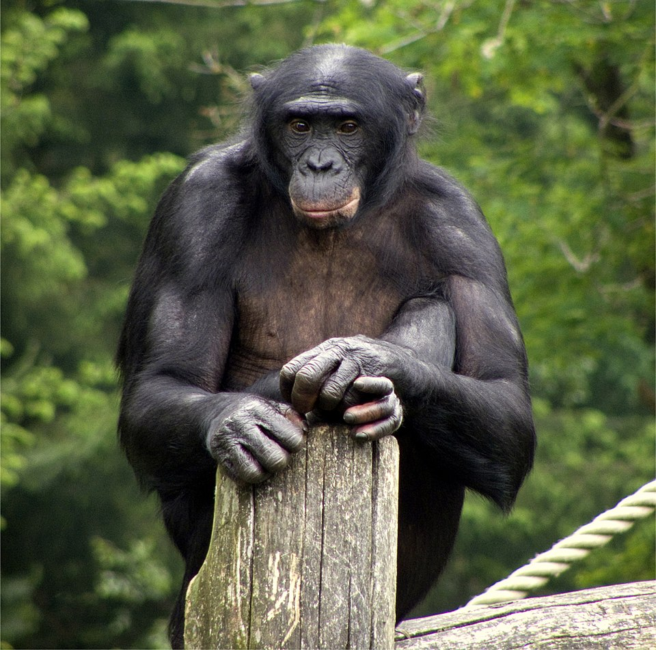



Primate of the Week
Bonobo
Pan Paniscus
Hippie of the great apes
Make love not war

Slide 3
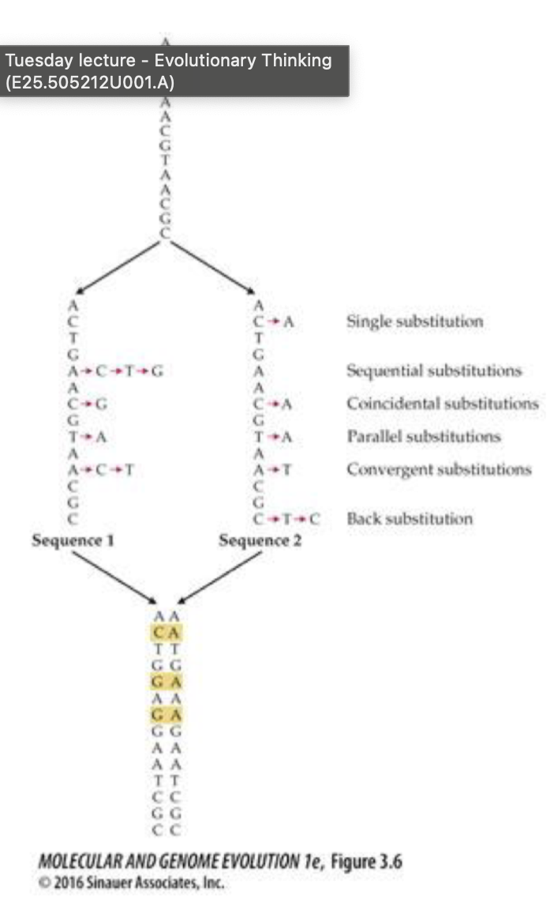
Nucleotide substitutions
Divergent sequences
AGATGCTAGCATCGACTAGCARCAGCTGACCCGCGCGCGCAT
AGATAATAGCATCGACTAGCARCAGCGGACCCGCGCGCGCAC
Different substitution models to explain this

Slide 4
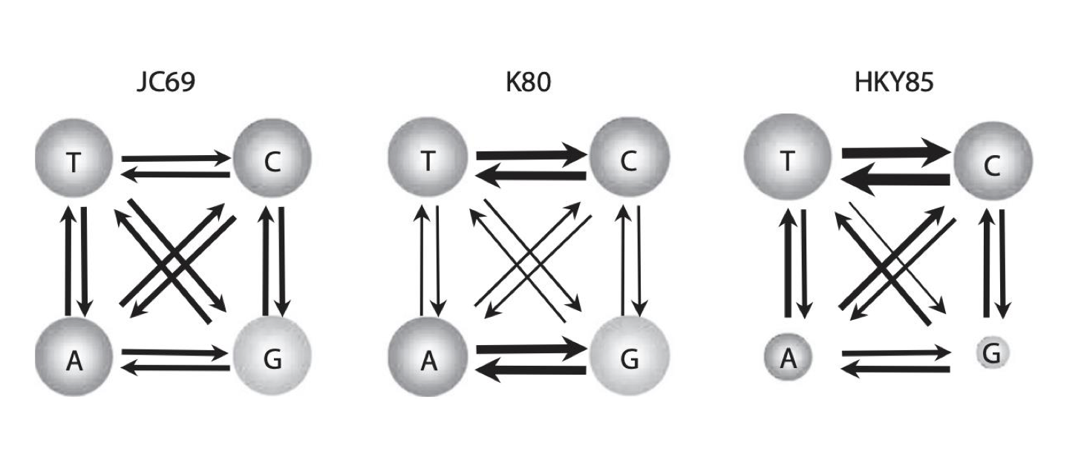
Substitution models
D-estimation -> proportion of nucleotide sites that differ
Jukes-Cantor -> corrects for multiple & reverse changes
+ separate rates for transition (A<-> G or C<->T) and transversions
Kimura’s 2 parameter model
+ Different equilibrium frequency distribution
HKY85
+ variability among sites
*Model* + Gamma

Slide 5
Substitution models
+ Gamma
+G
Variation in substation rates across sequence
Felsenstein 81
F81
Different equilibrium frequency for each nucleotide
Jukes-Cantor 69
JC69
Hasegawa 1985
HKY85
Single rate of substitutions
Different equilibrium frequency distribution AND unequal transition and transversion rates
Tamura and Nei 1993
TN93
Different equilibrium frequency distribution AND unequal transition and transversion rates for pyrimidines and purines
Kimura 80
K80
Separate rates for transitions and transversions
Notes:
Gamma distribution -> Variation in substitution rates across sequence

Slide 6
Which model is best
These are “Nested model” -> one is a special case of the other model
Simple models
Few parameters (LOW sampling variance)
Perform poorly for large distance
Complex models
Many parameters (LARGE sampling variance)
Better behaved for large divergence
Require LOTS of data
What is the true patterns of substitution ?

Slide 7
Likelihood function
Likelihood function
describes the distribution of probabilities that a model fitted to data describes it well
MLE (maximum likelihood estimation) – maximum value of the likelihood function for
model describing studied data
–> highest possible probability for the fitted model to really described the data
but more complex models are more prone to overfitting!

Slide 8
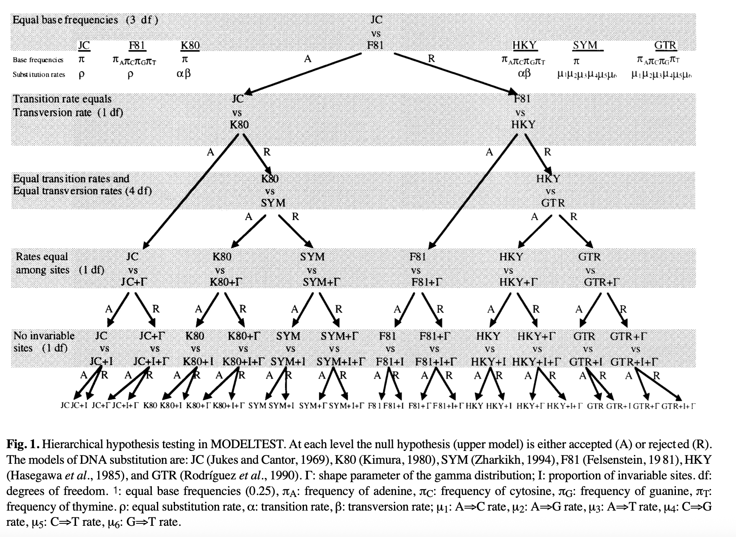
MODELTEST paper
Introduces an early solution for substitution model choice:
simple model likelihood pairwise comparison
Old but still a good early paper discussion resource

Slide 9
Tomorrow – MEGA exercises
MEGAX exercises: substitution models
Test different substitution models
Build phylogenetic trees :)

Slide 10
Insert Quote text, for next level ENTER and TAB
Insert Name

